Slide 1
ESF Land classification
Technology One users
Suggested process

Slide 2
How to update Revenue NSW data file
Step 1
Step 2
Update Data file with Valuation PID’s using existing data
Use Revenue NSW data file Valuation PID’s to update missing Strata property numbers if required.

Slide 3
Initial Assumptions
Database is up to date and all supplementary valuation lists have been entered and Valnet Alias’s have been updated with Valuation PID’s for each property number.
You understand how to use Alias Enquiry to identify all properties that have a Valuation PID.
Strata Valuation PID’s have not been kept up to date since 01/01/2016.
You understand the structure of your Strata Lots and can use Land Enquiry to identify these lots.
You have access to Profiler in Tech 1 and can create queries

Slide 4
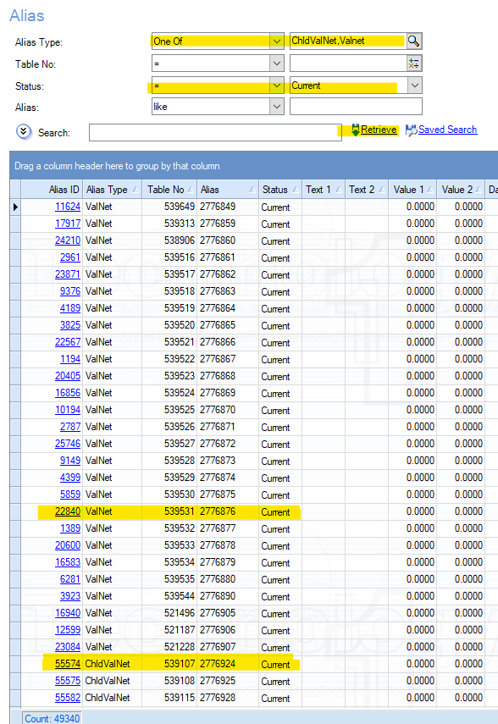
Update data file with Valuation PIDs using Alias Enquiry
  Using Alias Enquiry, an initial update of the Revenue NSW data file using current Valuation PID’s in your database can be done.
  Identify your Alias Type by selecting One Of from the drop down and then select your Alias Types by clicking on the magnifying glass and choosing the Alias identifiers for your Strata and Non-Strata properties that hold your Valuation PID’s (in this example ChldValNet & Valnet), the Status should equal Current and then click retrieve.
  If your permissions limit the number of rows retrieved, set up the same query using Profiler, use Nucleus/Alias for your Anchor and the same setup as the enquiry for your Query and Report.
  Once the query data has been returned output it to an excel spreadsheet.
  Use the example spreadsheet on the next slide to update your data

Slide 5
Example Spreadsheet
Right click on the example spreadsheet above click on Worksheet Object and Open. Overwrite data in all Columns with your own EXCEPT Column M. Copy formula already created in Column M
=XLOOKUP(C2,S:S,R:R,"Not Found",0) down to match the number of rows you require.

Slide 6
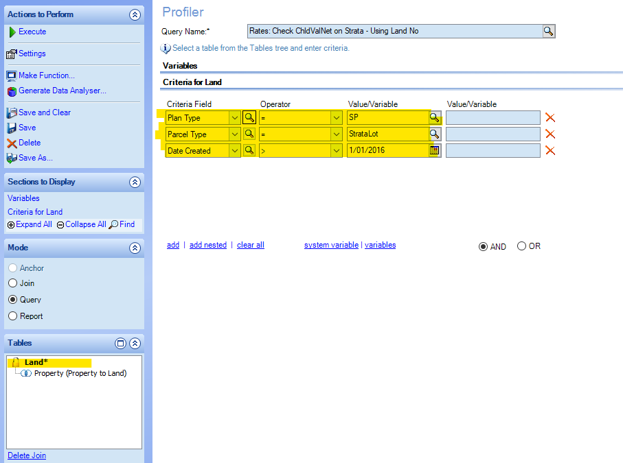
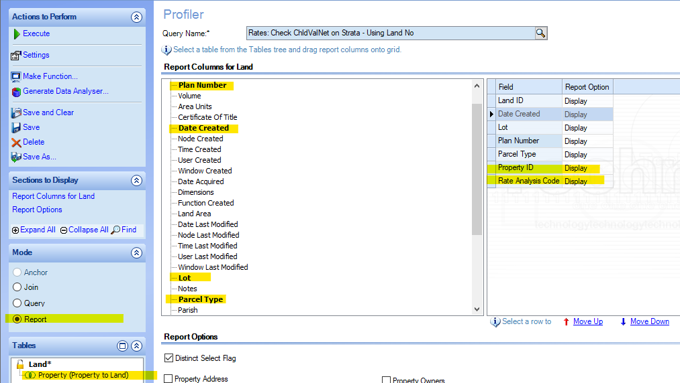
Update Valuation PID’s with Property Numbers for Strata’s that have not been maintained via Supplementary Lists
  If you have not maintained your Strata properties Valuation PID’s create the Profiler query on the right, this will allow the update of Strata Property numbers in the Revenue NSW spreadsheet data file using Strata Lot and Plan numbers already held in your database.
  Anchor Table under Mode, Select Nucleus, Select Land.
  Join under Mode, Select Nucleus/PropLand/Property (Property to Land).
  Set up your Query using Criteria Fields for Land table as highlighted in yellow.
  Set up your Report using from the Land Table, Plan number, Date created, Lot and Parcel Type. From the Property Table (Property to Land) select Property Id and Rate Analysis code, then Save
  Select Execute, then Report an excel spreadsheet will be created based on your Report setup.

Slide 7
  You now have all Lot and Strata Plans from Tech 1 in a spreadsheet.
  Return to your original spreadsheet where partial matches have already been made.
  Use the Filter function by Plan_Type=SP (Column L) and Filter by Property Id=Not Found (Column M) and copy result to a NEW spreadsheet.
  Highlight Column L in the spreadsheet and insert two new columns. Copy the Strata Plan number from column K to the blank Column L. Use Text to Columns function (Data>>Text to Columns or ALT+A+E) to split the lot from the plan. Once split highlight Column M and then using the excel function Find and Replace (Ctrl F) function to remove “SP” so only the plan number remains.
  Use the example spreadsheet on the next slide to update your data

Slide 8
Example Spreadsheet
Right click on the example spreadsheet above click on Worksheet Object and Open. Overwrite data in all Columns with your own EXCEPT Column O. Copy formula already created in Column O =INDEX(U$2:$U$150000,MATCH(1,(L2=$R$2:$R$150000)*(M2=$S$2:$S$150000),0)) down to match the number of rows you require.

Slide 9
  Once completed add to your existing Alias data in your original spreadsheet with the data from Valuation PID (Column C) and Property Number (Column O) and Copy the formula in Column M down to match the number of rows you require.
  The majority if not all your Valuation PID’s should now have a matching Property Number with the remaining “Not Found” rows requiring manual investigation.

Slide 10
Final Result
  The majority if not all your Valuation PID’s should now have a matching Property Number with the remaining “Not Found” rows requiring manual investigation.
  The next Step will be property Classification. A separate document will be issued for this process which for most properties can be accomplished using data already held in your system.

